Slide 1
West Bot Hackathon
Design, Architecture, and Demo
January 26th, 2016

Slide 2
Agenda
Introductions
About Neal Analytics (Company Background)
5 mins
Review of Your Current Situation/Objectives
10 mins
Bot Design Principles and Architecture - Break
30 mins
Bot Demos – QnA Maker Bot (OOTB), REI Bot (OOTB), Decision Tree Bot
45 mins
Q&A
10 mins

Slide 3
Agenda
Introductions
About Neal Analytics (Company Background)
5 mins
Review of Your Current Situation/Objectives
10 mins
Bot Design Principles and Architecture - Break
30 mins
Bot Demos – QnA Maker Bot (OOTB), REI Bot (OOTB), Decision Tree Bot
45 mins
Q&A
10 mins

Slide 4
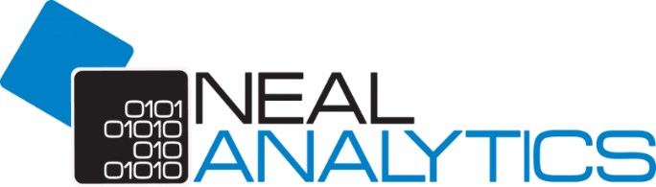
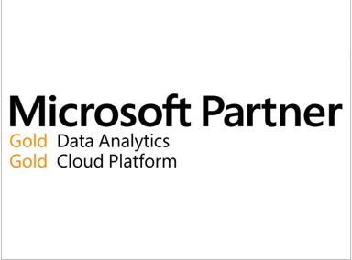
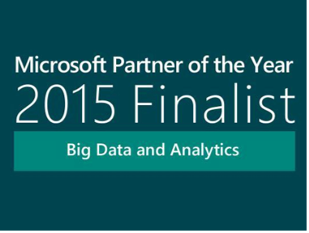

We are a specialist, Microsoft-exclusive SI(1)
Our Mission
Drive business value with Data/Cognitive Services, IoT, and Analytics on the Microsoft platform
Our Company
We are growing, Seattle-based company with 43 management consultants, application developers, data engineers, and data scientists that have helped dozens of customers improve their businesses. We were founded in 2011
Industry Alignment
Our objective is to make Data/Cognitive services, IoT, and analytics accessible to institutions of all sizes across our verticals. Our team specializes in creation of analytical practices to help companies grow and scale
Partnership
We are a Microsoft partner that has deep and meaningful relationships within the Microsoft Product Groups and Sales Organizations. We enjoy a two-way sharing of ideas and best practices
Services
Application Development and Integration, Cognitive Services Integration, Decision modelling, field management, process and machine optimization, and predictive success management
(1) SI: Systems Integrator; Our skills include developer tools (e.g. .NET, SQL), Platform (e.g. Azure, SQL Server), and methodology (e.g. Agile, ITIL)

Slide 5


Why Neal Analytics?
Business
Focus
Work back from profit drivers to the actionable issues on which data science can provide insight or governance
Modern technical infrastructure
We focus on cloud-based analytics: economy, secure sharing of results, advanced functionality and on-demand capacity
Data Engineering & Data Science
Expertise
Our experience spans structured, semi-structured and streaming data sources; our data science staff includes Ph.D.’s, engineers, and MBA’s
Deep Microsoft Experience
Our practice exploits Microsoft Platforms; and we take full advantage of our proximity and Gold Partner status to remain current and participate in previews
Technology Transfer
We transfer our data models to your staff and provide training on any part of the tool chain you require

Slide 6
Engagement Models for Neal Analytics
Project-Based Work
Managed Services
Talent Solutions
Highly defined statements of work written by sales in conjunction with delivery due diligence
Defined engagement cycle and timeline for delivery with incremental deliverables
Works best for projects with a definable outcome and goals with organizational buy-off within customer
Staff operates under guidance of Neal management with an engagement cadence defined in the statement of work
Deliverable, retainer, or milestone based billing to support client needs
KPIs and SLAs define the hallmark of a successful multi-year long-term outsourcing arrangement
Ratios of people defined for tasks and job-roles enabling hybrid teaming and staffed resource scalability across multiple projects & organizations
Staff engages under advisement of managerial lead, from either Neal or Customer who defines sprint-based engagement cadence for managed services
Highly defined outsourced value proposition and firm-based engagement cadence
Billing based on defined monthly engagement cadence, or paid by retainer in advance
Skilled human across a ride range of tech skill areas to augment long or short-term needs
Annual, monthly, contract to hire, and executive search engagement models
ARIBA and other HR system compliance
Wide network and ability to fill any role across data, analytics, engineering, marketing, sales, and operations
Engagement defined by direct management of resource by customer

Slide 7
Services Areas
Infrastructure
Data & Visualization
AI & Machine Learning
Azure Lift and Shift
Database / OS / Apps
ERP / Enterprise Apps
Datacenter Migration Services
SQL On-prem to SQL Azure DW
Competitive win backs
Big Data Architecture/Migration
Enterprise Architecture
Azure AD
Master Data Management
Advanced Data Services
HPC
Video Services
PowerBI Back-end
PowerBI
Azure Analysis Services
SQL DW, SQL IAAS, SQL Azure
Data Management (ADF, Event Hubs, Data Lake, SQL Azure DB, SQL Azure DW)
SQL Server/Developer
Microsoft R Server
IOT (Stream Analytics, ML models)
Data Warehouse (SQL Server, Azure SQL DW, Azure SQL)
Azure Data Lake
HDInsight, ClouderaSparkR, Hadoop Animal Farm (ELK stack, etc.)
Finished Solutions available in and separate from AppSource
Retail: SKU-Max, Market-Mix
Manufacturing: Quality-Max
Ops/Supply Chain: Predictive Maintenance, Asset Mgmt.
Bots: Business process Automation, Expert System
Special Projects
Advanced Analytics projects
Bespoke/custom engagements for a net-new scenario ($$$)
Business/Technical Envisioning sessions
Executive Envisioning Workshops
Microsoft-based Product Optimization

Slide 8
Finished Solutions: Technology Scale
 | Retail/CPG | Manufacturing
Sales & Marketing
Product & Competition
Ops & Supply Chain
Sales Driver Analysis
Sale/Ordering Agent
Bots:
Sales Expert System
Product support and integration
Tier 1 of Support
SKU Optimization
Pricing Optimization
Quality Management
Stock Replenishment
Asset Management
RUL-Predictive Maintenance
Field Service
Complete
In Progress
Planned

Slide 9








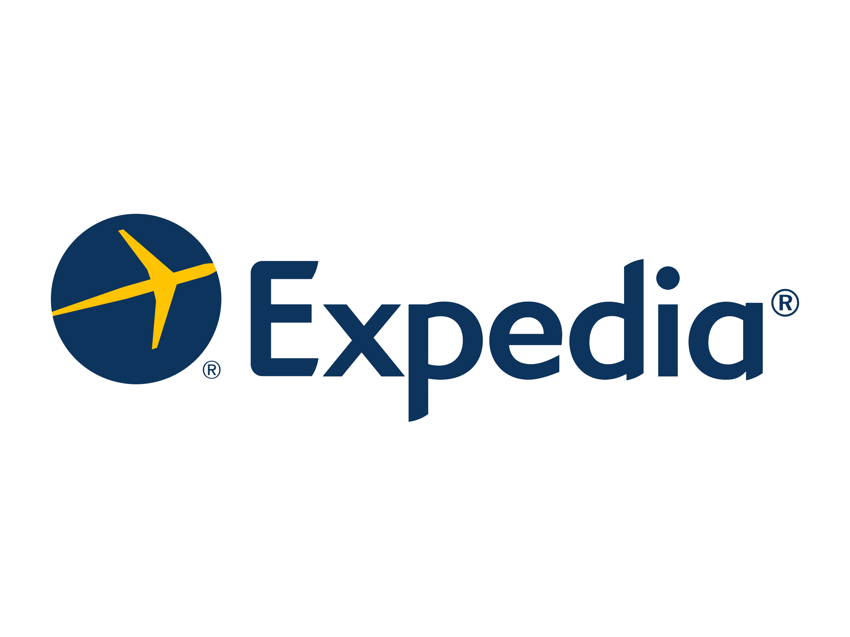




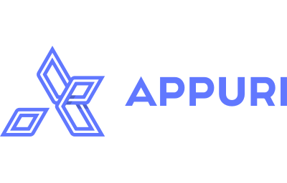
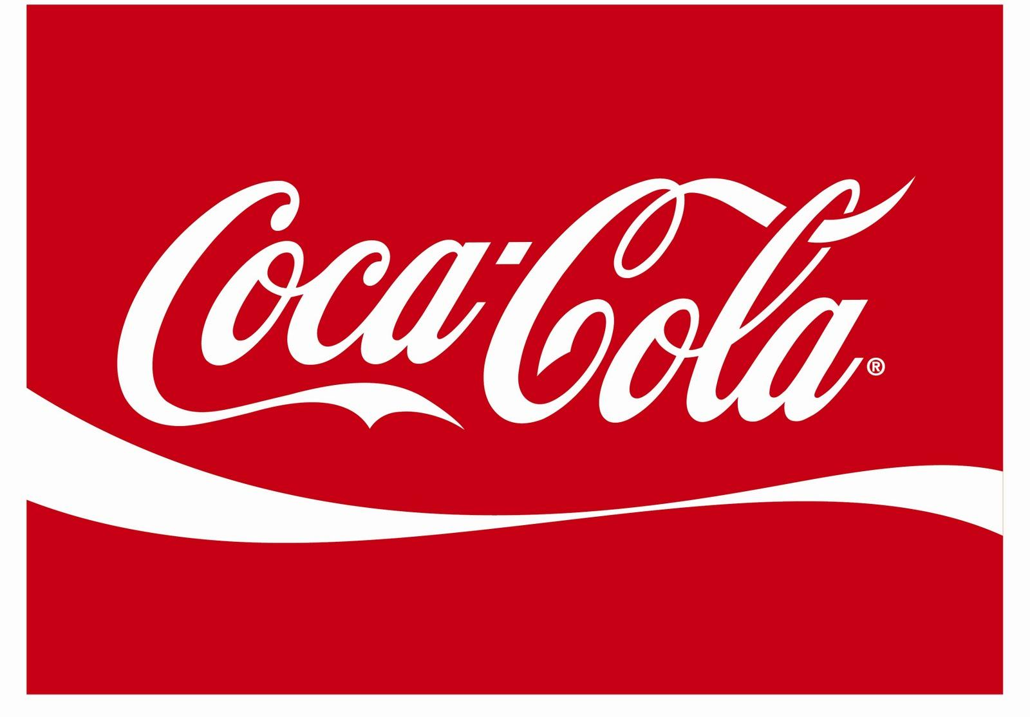




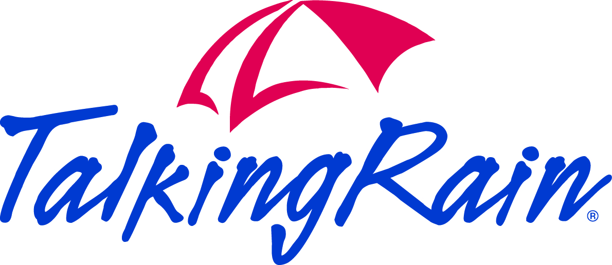



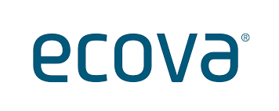

Some Neal Analytics Customers …
Notes:
Who do we do it for? (potentially move up)

Slide 10
Objectives and Approach
Business Objectives
Approach
Increase personnel effectiveness by enabling employees to find the right answer to understood questions automatically
Speed up action by reducing costly delays and out of support hours gaps. Lower data access barriers, leading to faster delivery and time to market reductions for new support materials
Empower employees by creating additional time for intellectual and creative resources to focus on high value activities such as strategy and innovation
Translate Business logic and information system architecture into a graph that can be searched and traversed using a chat bot
Integrate bot and data sources so ERP data can be consumed and leveraged by chat bot
Train artificial intelligence systems to understand English expressions and translate them into commands to retrieve information from the program
Humanize interface by adding emotion to responses and leveraging common user interface (Skype).

Slide 11
Advantages of Bot Automation
Better
Improved Accuracy/Compliance
Faster
Time Savings
Cheaper
Lower Cost To Serve
Improved compliance with FastTrack processes from people (users & support agents) wanting to engage
More accurate outcomes from better policy adherence & knowledgebase adherence
Reduced tactical mistakes due to improved availability of information
Improved Scale of Service (out-of-hours support)
Response turnaround reduces to minutes
Efficient navigation to the answer, no need to peruse FAQs
Improved speed of execution due to easier access to needed information, systems, forms, and other FastTrack processes
Up-leveling valuable personnel from route tasks to value-adding activities
Lower FastTrack help desk costs
More efficient usage of help desk time through tiering of issues
Improved ROI of FastTrack groups due to more time spent on high value strategic initiatives

Slide 12
Key BOT Use Cases
Process Automation & Expert System
Support Response Automation & Q+A
Automated Sales
Programmatic hooks into process database with write-back capability
Expert process knowledge to facilitate process progress and adherence
Distinct pathing and expertise in order to answer questions
Reductions in processing time due to 24/7 availability of an expert
Ability to integrate with other BOTs and systems.
Azure Search configured over highly relevant content provides a seamless way to do deep indexing
Existing Q+A features and ability to store historically successful answers enable great email & chat support
Scalable BOT allows for support staff requirements to remain minimal as companies use technology to scale
Lower FastTrack help desk costs
More efficient usage of help desk time through tiering of issues
Improved ROI of FastTrack groups due to more time spent on high value strategic initiatives

Slide 13
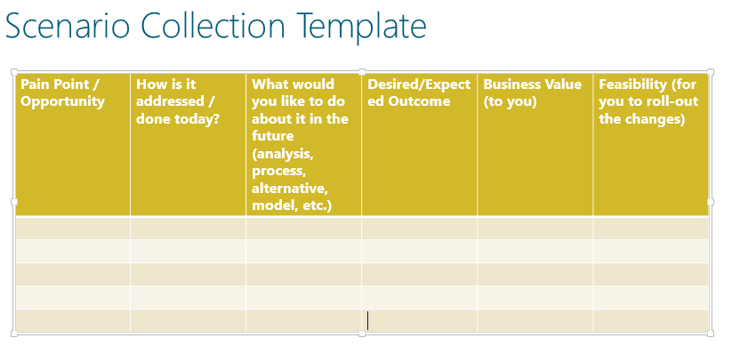
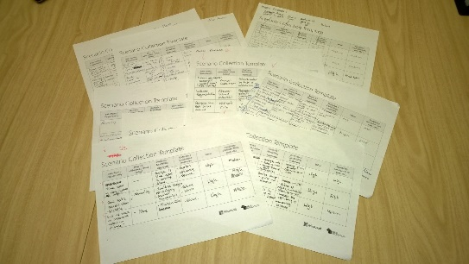
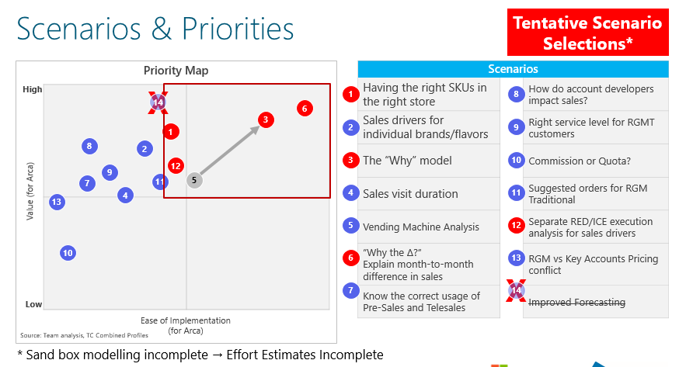
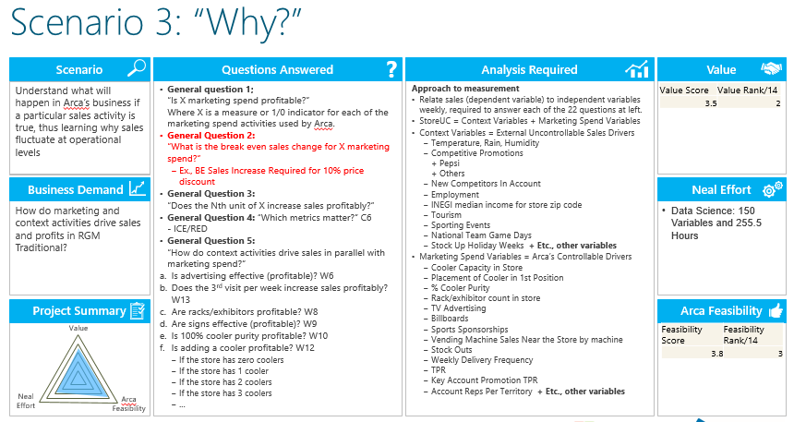
Typical BOT Roadmap - Services
Key
1 & 2 are initial engagements with scoping components included
3 & 4 are UAT Phases
5 & 6 are production & post production
START
1
BOT Envisioning Workshop - $10K with limited BOT delivered
Scaled Down BOT Development Support
$10K / month for 3 months
Reduced training schedule
CB: Improve slide 7 and replace this image3
2
4
Support Operationalization
$5k / Month
Continued training & support for the BOT
3
6
POC BOT Engagement
$40K-$80K,
2 month long engagement designed to produce minimum viable product
5
Up-Front Intensive BOT training
- $20K / month for 2 months
- Resolution of immediate issues and full-time support
CB: Blur out all text here
Additional Feature Development
$TBD
Features costed on a per-feature basis depending on .Net integration required
CB: Put a dollar sign and clock gif below this title
CB: Blur text
CB: Blur text
CB: Blur text
CB: Blur text
CB: Blur word Arca
CB: Blur word Arca

Slide 14
BOT Acceleration Managed Service Value
Standard staffing run-rate for existing functions automated by a BOT
90% Automated
80% Automated
70% Automated
CB: Improve slide 7 and replace this image3
BOT development cost
Month 1
Month 2
Month 3
Month 4
Month 5
Month 5
Month 6 & on
POC / Workshop
Intensive Development
Scale Down Development
Train, Improve & Maintain
CB: Blur out all text here
CB: Put a dollar sign and clock gif below this title
Accelerate your team
Use Neal Analytics’ BOT knowledge to build faster
Leverage Neal’s Machine Learning know-how to train for a better tomorrow
CB: Blur text
CB: Blur text
CB: Blur text
CB: Blur text
CB: Blur word Arca
CB: Blur word Arca
Notes:
Blue is money to Neal
Light blue is standard staffing run-rate for existing functions automated by a BOT

Slide 15
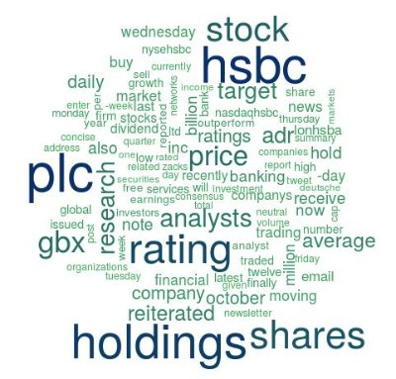
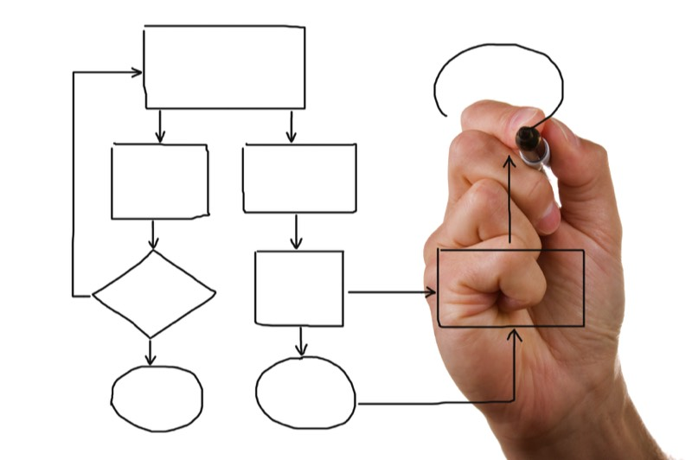
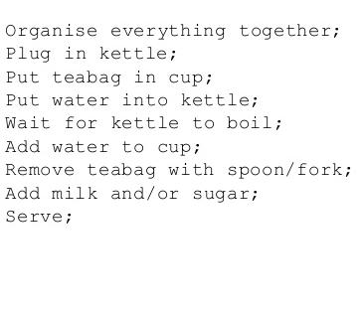
Three Paths to Bot Interaction
Natural Language
1
Business Process
2
3
Logic Programming
Bot respond to direct questions related to procurement in conversational form
Bot follows business logic matching desired procurement process
Bot can be updated by uploading simple instructions into a database
How to make tea?

Slide 16
Bot Conceptual Architecture – Helpdesk Agent
“Intelligent” Chat Bot Agent
User Seeking Help
Interactive, Intelligent Automated Support Technology with “self-healing” characteristics: converses, clarifies, and self-learns/improves
Backend logging system keeping track of interactions
Query about specific content or action thru Azure Search
Structured Knowledge Enhancements
Real-time adjustments
“Curated”, periodic adjustments
Knowledgebase
Support Content, Document management Systems, Rules Engine, Expert System, Q&A
*Unconstrained* “Art of the Possible, Budget & Timeline no bar

Slide 17





Bot Technology Functional Architecture – Process Bot
Neal Analytics Architecture in Azure
Skype serves as user interface. Bot leverages native capabilities of Skype, is embedded in a webpage or operates via email
User Seeking Help
Business Logic is encoded in SQL. This facilitates flexibility and extensibility
Bot framework serve as core connector and communicates with Skype, SQL, and LUIS.
Bot Framework
Process Flow
User Choices
Next Prompt
Action
Actions
Action
Log
User Choices
Action
Timestamp
Solution is hosted in Azure, a highly flexible and powerful cloud platform
LUIS Model provides natural language understanding
LUIS Model

Slide 18
A System That Grows Smarter With Use
Natural Language Improvement
Natural Language Learning
A log is kept of all user inputs (text and selections)
Text and Selections can be used to retrain natural language models
New model is published
Auto-populate to all end points
Business Process Improvement
0.3
E
0.7
A
Business Logic Learning
0.4
A log is kept of all user inputs (text and selections)
Paths which lead to dead ends or loops can be analyzed and improved. New branches built
0.6
New Business Logic is updated in SQL
Auto-populate to all endpoints
Notes:
Promos / New Menu Items - every 6 weeks there is a new menu item
-Is a refresh going to be deployed in the technology of each store?
Accuracy / New Learnings – Positive Feedback that learns from the technology in the field

Slide 19



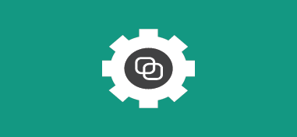


Microsoft Cognitive Services enables bot functionality to be extended
Cognitive Services
Vision
Speech
Language
Knowledge
Search
Computer Vision
Customer Recognition
Bing Spell Check
Academic Knowledge
Bing
Web Search
Emotion
Speaker Recognition
Linguistic Analysis
Entity Linking
Bing
Image Search
Speech
Language Understanding
Knowledge Exploration
Bing
Video Search
Face
Text Analytics
Recommendations
Bing
News Search
Video
Web Language Model
Bing
Autosuggest
Translator

Slide 20


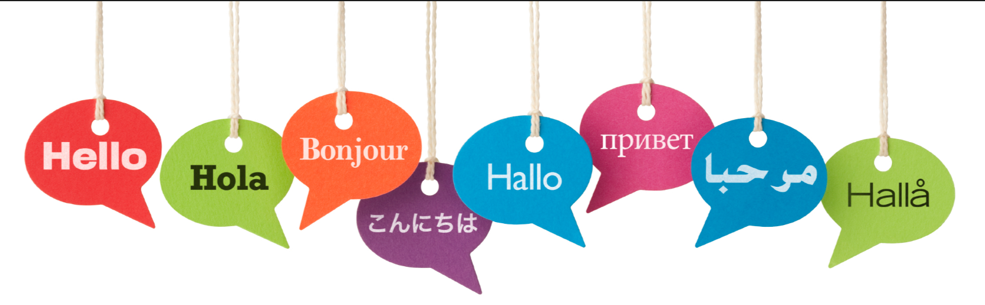

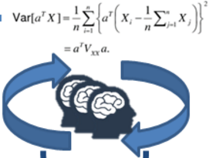

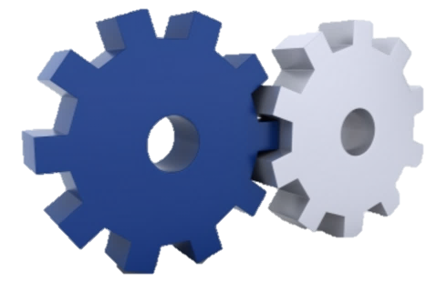
Scaled Implementation
Users
Active Directory Integration
Infinite scale through Azure cloud fabric
Language
Abstracted language framework for easy extensibility (meta-data driven content organization and text/labels)
Language packs to unlock bot methodology and training in other languages
….
Bot Portfolio
Bot Hierarchies
Departmental Bots
Bot Frameworks for easy instantiation and shared learning
Human-in-loop
Proactive and reactive failover to humans
Enhancement through the human pre-processing and checks
Brand and Customer SAT assurance
Localization
Local Style/Intent/Culture
Sentiment/EQ tracking
Emoticons and symbols
Integration
Bi-directional info flow with the enterprise systems of record (apps)
Business-aware and business ROI focus
Scale to 10,000+ employees
Knowledge/Skills Transfer to West IT/Procurement
Small-footprint (users, location) Pilot
Limited Rollout (complete dept/geo)
Broad Rollout
Sustain Steady-state
Remediation & Support
Continuous Improvement (models)
Key Success Factors
Efficient design and hooks for scaling and max throughput
Expand “load” to test multiple stores (<10) – concurrency, variability in speech
Phased rollout to regional clusters and national scale – change management
Stabilize, monitor SLAs, rapid stabilization sprints
Steady-state improvements, on-going menu changes, user support
Accuracy and impact assessments and improvements

Slide 21

Real-time view into performance of Bot
ILLUSTRATIVE
Considerations
Bot Management and Performance Interface
The number of interactions fed to bot system
As the POC progresses, LUIS will continue to show improvement in learning and interpretation
Sentiment data can provide additional opportunities to consider
Automatic logging of activities will enable greater visibility into procurement processes, allowing for development of more efficient processes
Procurement Process Performance
Bot Performance
Interrupted Bot Interactions
Average Daily Bot Queries

Slide 22
Bot Features Overview
A
Chat/IM Interface
B
Integration and Workflow
Variety in the chat interfaces (standalone web client, Skype)
Carousel-based UI to display options
Understand intent and conversation context
Natural, human-like interactivity
Integration to the Document Management Systems
Integration to Ticket Management Systems
Integration to ERP/CRM systems
C
Self-improving/Learning
D
Security & Data Integrity
Flexible LUIS framework to support improved natural language understanding over time
Easily programmable business logic design to allow for modifications and improvements
Secure capture of text and voice transmission to the Azure Cloud (secure end-points)
Integration to Azure Active Directory and User Access Rights
E
Admin
F
Visualization
Activity Logging: Capture all activity user, client IP, alias, Company, etc.
Manage access, locations, integrations
Manage ML refreshes and custom module deployments
Visualize the most frequently asked topics
Visualize graphs of how users traverse topics
Visualize feedback and usefulness scores
Infra: Azure Consumption and Mgmt. Dashboard
G
Historical and Trending
Trends in Chat Bot performance
Trends in Utilization, Frequency, Unique Users
Trends in User/Customer Sat metrics

Slide 23
Agenda
Introductions
About Neal Analytics (Company Background)
5 mins
Review of Your Current Situation/Objectives
10 mins
Bot Design Principles and Architecture - Break
30 mins
Bot Demos – QnA Maker Bot (OOTB), REI Bot (OOTB), Decision Tree Bot
45 mins
Q&A
10 mins

Slide 24
Demo
West QnA Maker Bot
http://westchatbot.azurewebsites.net/
QnA Source
West Basic Bot
http://westdemo2017.azurewebsites.net/
Basic Bot Source
West Decision Tree Bot
http://westbotprocurement.azurewebsites.net/
Decision Tree Bot Resources

Slide 25
Agenda
Introductions
About Neal Analytics (Company Background)
5 mins
Review of Your Current Situation/Objectives
10 mins
Bot Design Principles and Demos - Break
30 mins
Bot Demos – QnA Maker Bot (OOTB), REI Bot (OOTB), Decision Tree Bot
45 mins
Q&A
10 mins

Slide 26
Why is Neal Analytics Different?
Management Consulting Pedigree

Specialist Microsoft Cloud (Azure) Expertise for Advanced Analytics, Data, and Cognitive Services

Deep and meaningful MSFT technical/Product Group access
Notes:
What is actual being offered – skipping to the why its better?

Slide 27
Appendix

